Slide 1
Welcome to the ED Orientation on-line module
A L I N A T S Y R U L N I K M D
A S S I S T A N T P R O F E S S O R
A S S O C I A T E R E S I D E N C Y P R O G R A M D I R E C T O R
D E P A R T M E N T O F E M E R G E N C Y M E D I C I N E
Y A L E U N I V E R S I T Y S C H O O L O F M E D I C I N E

Slide 2
Goal of this Orientation
Prepare our off-service rotators for patient care in the ED from the moment they start their rotation

Slide 3
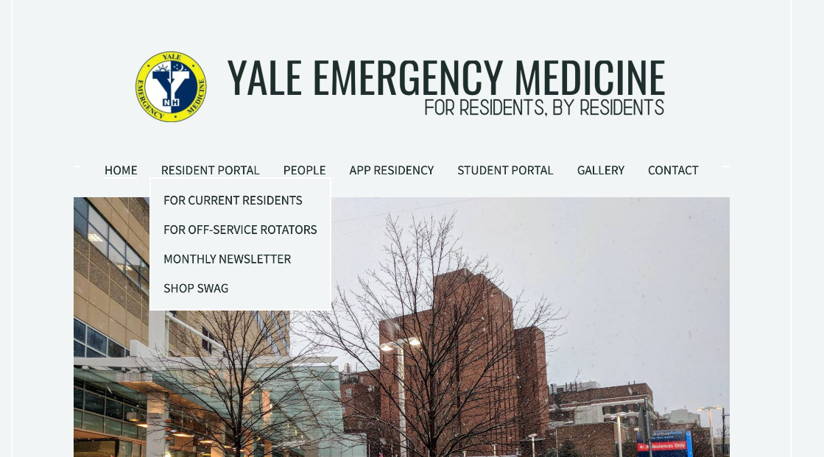
ED Rotation Orientation Process and Resources
Mandatory
ED orientation (mandatory): you are here
ED online module (mandatory):
yaleem.org > Resident Portal >For off-service rotators
Password: yaleem

Slide 4
Objectives of this Orientation
Logistics of working in the ED
COVID-19 Considerations
Your ED team
Sign out
Observations vs. Admission
EPIC details
Placing Orders
Writing Notes
Admission/ Discharge
Top off service resident Pitfalls and How to avoid them
High Yield Emergency Medicine Topics
Cardiac Chest Pain
ACS: STEMI vs NSTEMI
Low/Moderate Risk CP
Anaphylaxis
Trauma
C Spine precautions
E Fast Exam
Intoxicated patient
Psychiatric patient
Medical clearance

Slide 5
LOGISTICS OF WORKING IN THE ED

Slide 6
COVID-19 Considerations
PPE: we have it, it needs to be used appropriately.
Located in the PPE carts in each section in the ED, ask a nurse or your attending to help locate
Use ONE N95 (or equivalent mask) per shift
You should know the size: regular or small
Surgical masks: can be used to see non-respiratory complaints
Face Shield/Gloves/ Disposable Gown/ Hair cover are used for invasive procedures (including IV insertion, etc.)
P100 Masks are available in the ED to use for your shift. You must bring your own filters.
Ask a nurse or attending where to locate these masks
Must be returned at the end of your shift
A mask must be worn at all times when at work
Notes:
Are P100 masks available to off-service rotators at this time?

Slide 7
COVID-19 Considerations
Stay safe:
Never enter a patient room without appropriate PPE
Stay adjustable:
Things change daily: administratively and clinically, the attendings and residents in the ED will be familiar with the most up to date information, please approach them with any questions

Slide 8
ED Layout
Section A: Mixed Acuity- open 24/7
Staffing:
2 attendings 9am-1am (1 attending 1am-9am).
Any off-service resident may be assigned to A side.
The off-service residents will present all patients to the PGY4 EM resident.
Trauma: All trauma patients that go to resuscitation bays are designated as “full” or “modified” trauma
Off-service residents are not responsible for taking care of “modified” or “full” trauma.
Off-service residents are responsible for trauma patients that don’t meet “modified” or “full” trauma criteria.
Resuscitation Rooms- ”R- Rooms”
Highest acuity patients go to these rooms.
Discuss with the PGY4 on A side which R rooms you should be designated to (generally R1 and R2), respond to these R rooms when the alert is made overhead.
Notes:
Edited to show any resident can be on A side, and clarifying that generally R1 and R2 are rooms that off-service rotators should go to. Also clarified that A side is mixed acuity.

Slide 9
ED Layout
Section B: Mixed Acuity- open 24/7
May still get trauma patients that are not “full” or “modified” traumas
At least 2 residents, always at least 1 senior EM resident (PGY2-4)
Staff patients directly with the attending
Section C : Boarding/Admitted Patients
You will not work any of these shifts
Annex: Lower acuity
Staffed by APPS; you will not work any of these shifts
Express Care: Lower Acuity- occasionally open during busy times
Located in the ambulance bay and hallway beds in A side
Staff patients directly with the attending
TRIAGE IS NOT A PERFECT SCIENCE- APPROACH EACH PATIENT AS IF THEY COULD BE VERY SICK
Notes:
Clarifying that C side for boarding/admitted patients (w/ no shifts there), and that B side is now mixed acuity
Left the part about Express Care as is, but not sure this is the most realistic anymore (in recent months have mostly seen with just boarded patients
Added section about Annex

Slide 10
ED Layout- Other areas
Patient entrances/ triage/ registration areas:
Ambulance
Waiting Room
Crisis Intervention Unit (CIU) = Psychiatric ED
Separate unit staffed by psychiatry residents, attendings, nurses, techs
Prior to going there, patients >50yr old must be medically cleared
Chest Pain Center (CPC)
Separate ED observation unit for low/moderate chest pain patients
Staffed by B-side attending, PA (during working hours), nurse, tech

Slide 11
Your team:
Attendings
May be supervising multiple sections during one shift
Can be reached on mobile heartbeat if they are sitting in a different section
24/7 in-house coverage
Senior ED Resident
PGY4 resident always on A side
PGY2-4 on B side
ED Nurse
ED Technician
Information Associate (IA)
Notes:
Clarified that a PGY2-4 EM resident on B side

Slide 12
Your ED shift: Arrival and Sign-out
Arrive at least 5 min. prior to scheduled time
A side: Group sign out at 7am, 3pm, 11pm located in the “bubble” by room A15
Senior residents will present patients
”A Surge” residents sign out to each other or to the PGY4 they are working with and spend the last hour of the shift after sign out wrapping up patients and notes
B side: Group sign out at 7am, 3pm and 11pm
Off service residents usually receive sign out from the outgoing off service resident. Discuss this among the residents before sign out
Attendings usually present patients, junior residents provide details as needed
If you are on a swing “surge” shift you can start picking up patients and sign out to a resident staying on B side if you have existing patients after your shift ends
After sign out, spend the last hour of your shift wrapping up your patients and finishing your notes.
Notes:
Removed section on C side and Express Care.

Slide 13
Your ED shift: Seeing patients
See patient in Parallel (not sequentially)
Ideally see them within the first 5 minutes of arrival
Present your patients as soon as you see them to senior (A side) and/or attending (B or A side)
Assign yourself to new patients that appear red within your section
When taking sign out on patients, assign yourself as the new resident caring for the patient
Notes:
Edited that all patients should be ideally seen within 5 minutes of arrival (since mixed acuity), and clarified who to present to on A vs B side

Slide 14
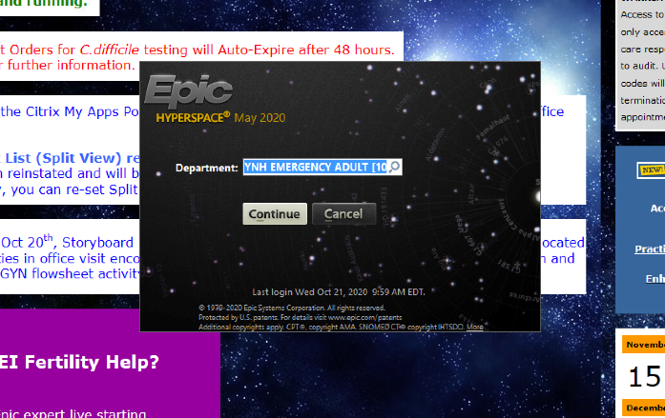
Your ED shift: Signing up for patients
Sign into the ED context
“YNH Emergency Adult”
Once in Epic, go to the ED Track Board and sign into the ED, at the end of the shift you can “sign out” using this button as well to unassign patients
To assign yourself to a patient, click on the patient, right click then “assign me”
1.
2.
3.

Slide 15
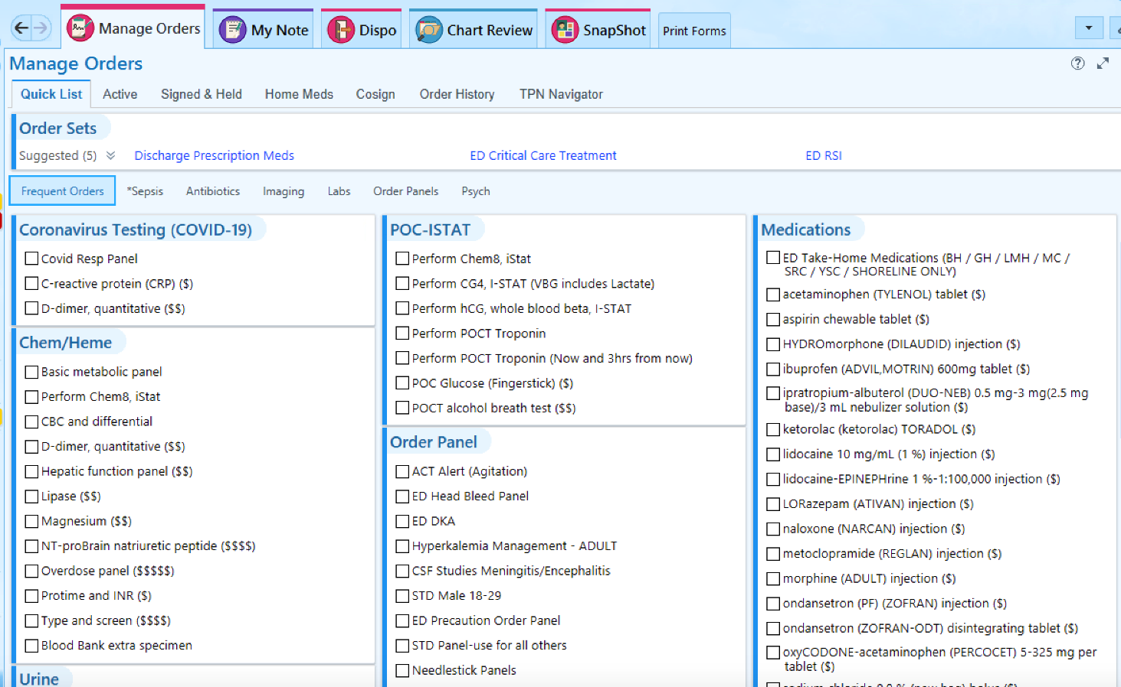
Your ED shift: Orders
Discuss with you attending or senior resident before entering lab and imaging orders
Use the ED “frequent orders for majority of labs, imaging and antibiotics to ensure you are entering the correct orders
Enter orders ASAP

Slide 16
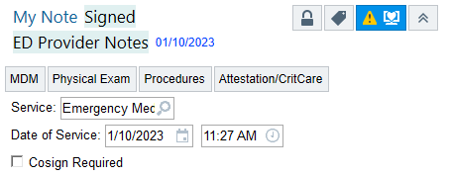
Your ED Shift: Notes
Open Patient’s Chart> Click “My Note”> ED Provider Note
As of January 1st, 2023: THERE ARE NEW CODING GUIDELINES!!!
There are no longer HPI and ROS elements that must be completed in every note
Coding is now based off the MDM which is now
emphasized in our documentation
The MDM is free text

Slide 17
Your ED Shift: Notes
In the MDM, please include:
The patient’s PMHx and presenting story (HPI)
DDx you are likely considering (i.e., for a CC of chest pain-> ACS, PE, or PNA, etc.)
Tests you are considering or deferring for the most emergent Dxs (i.e., considered PE but patient was low risk per PERC criteria, no d-dimer ordered).
Updates and/or changes to patient status:
Improvement after meds?
Worsening vitals
Final disposition
Etc.
Instead
IF YOU HAVE MDM QUESTIONS, ASK YOUR SENIOR OR ATTENDING
Notes:
If you want examples/really want to get into the weeds, review these videos:
https://www.youtube.com/channel/UC3fAQ5rTGQDXv4FtbU31pHw

Slide 18
Your ED Shift: Notes
Include a physical exam
If you did any procedures use the
procedure tab
You do NOT need to write in the “Attestation/CritCare” section (attendings will document there)

Slide 19
Your ED Shift: Notes
When Finished Documenting: Share
When an attending has signed the note, the system will only let you “sign” the note
Pick your attending co-sign
Do not start 2 separate notes

Slide 20
Your ED shift: Disposition
Important to notify the patient and nurse as soon as the decision is made to admit or discharge
NEVER discharge the patient prior to making the ATTENDING AWARE that the patient is being discharged
AMA discharge: ALWAYS alert the attending ASAP
Document capacity to make decision
Can not be: intoxicated, mentally retarded, cognitively impaired
Give appropriate discharge instructions and prescriptions
AMA form must be signed by patient
Encourage return to the ED

Slide 21
Your ED shift: Admission vs. Observation
Reasoning: patients who have normal vital signs, normal lab results, normal imaging may not meet criteria by insurance companies to pay for a full hospital admission
These patients may still require medical care not reflected by the criteria
Logistics: most of the time, the ED attending will be able to determine admit vs. obs
Care Coordinators are specially trained in making the decision
Will sometimes ask you to change the admit→obs or obs→admit booking
The attending makes the final decision

Slide 22
Your ED Shift: Medical Admission
Enter order in EPIC: “ED Admit” under frequent orders
Observation vs. Admission
Medical Admission
For Attending:
“YNH Hospitalist” for general medical admissions
If cardiology, the cardiology fellow will give you the name of the attending
For Klatskin, call the Klatskin admitting resident signed into the dynamic role on mobile heartbeat to get the name of the attending
Non-Medical Admission
Surgical Services (including OB/GYN), Neurology
Need a specific attending name from the consulting resident to put into the order
Level of Care
”Floor” for most admissions
Step down and ICU admissions require a specific attending name
Fill out the rest of the booking (specify tele vs. floor)
Notes:
Added that OB/GYN is a non-medical admission

Slide 23
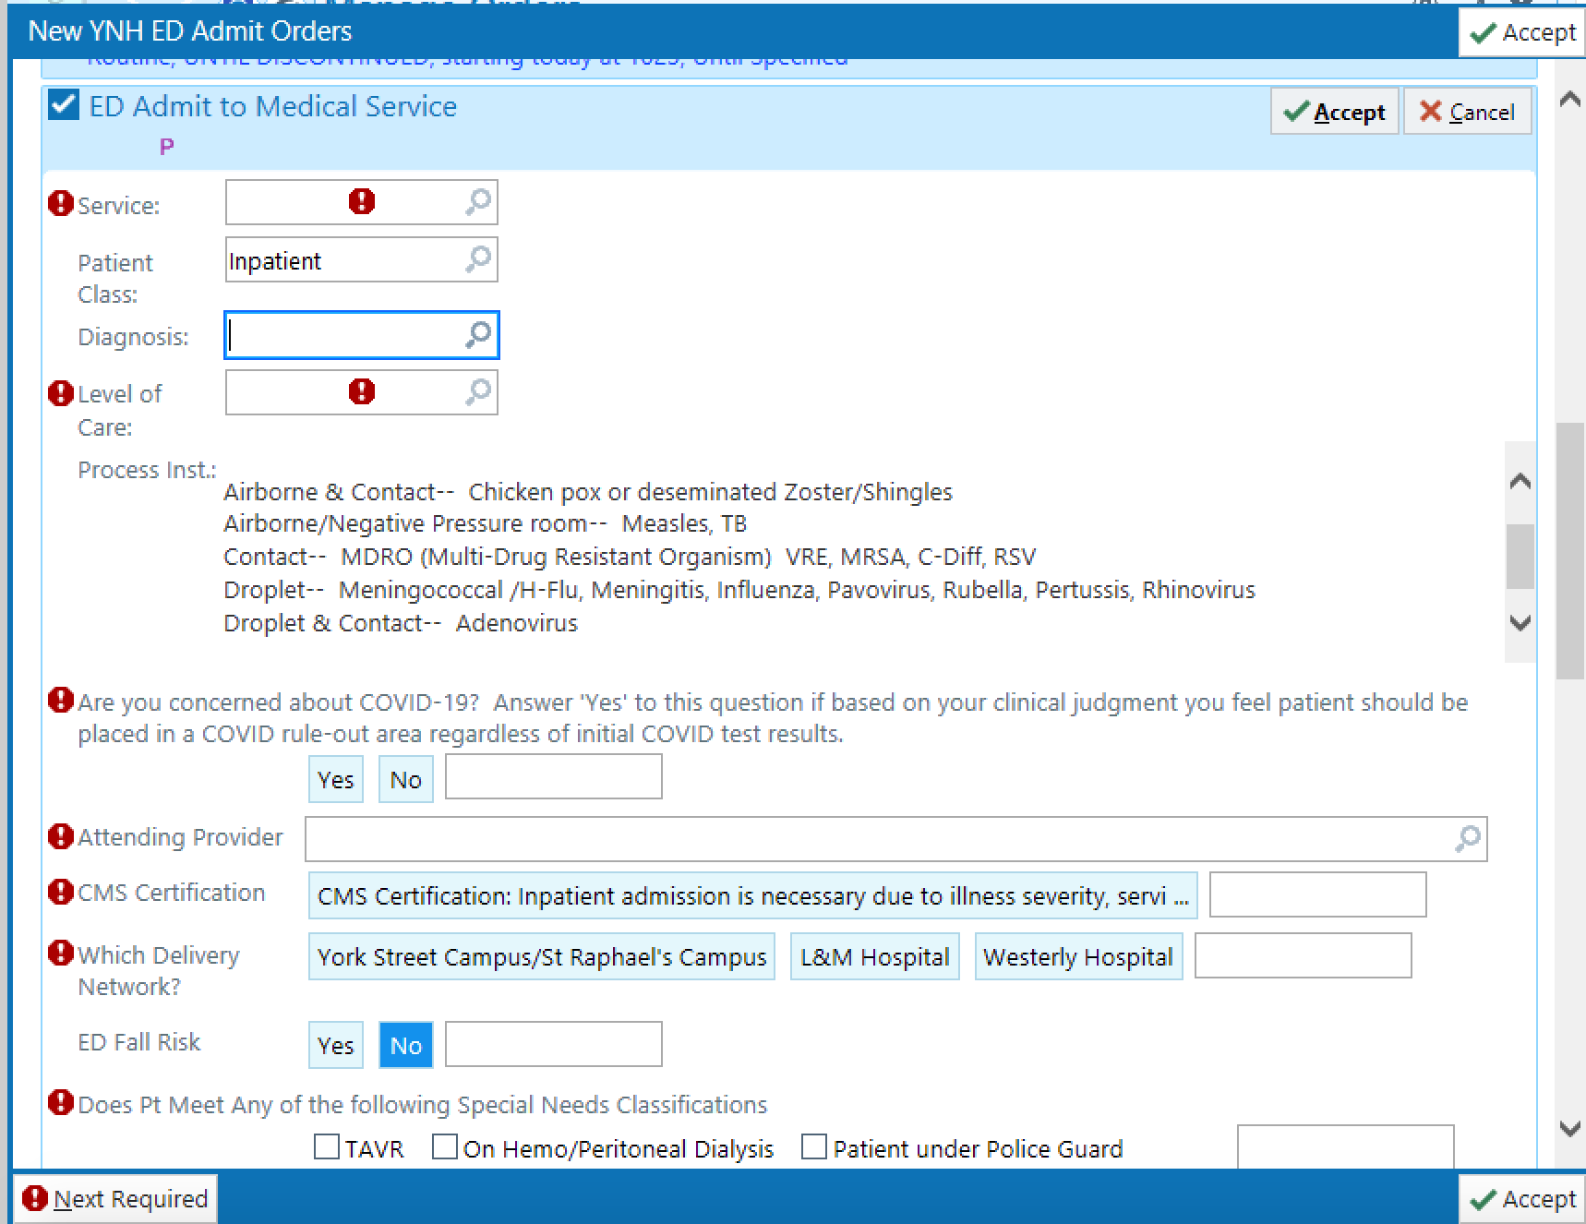
Your ED Shift: Admission
1.
3.
2.

Slide 24
Your ED Shift: Admission to an ICU
YNHH admission policy: the ED attending makes the final decision where a patient is admitted
The attending or senior resident will contact the MICU or SDU attendings to discuss admissions
Additional ICUs
CCU: page CCU fellow
Surgical-ICU: the surgical team is responsible for getting SICU attending approval
Neuro-ICU: don’t need to page anyone b/c you are admitting to a team that should already be involved in patient care

Slide 25
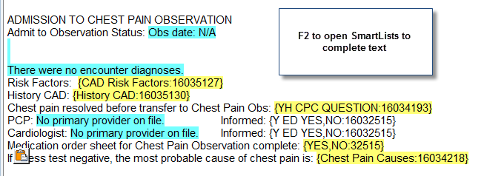
Your ED shift: Admission to CPC
CPC or in-hospital ROMI
Both:
low/ moderate risk chest pain patients who need a ROMI
Observation, telemetry admission
Not for ACS patients
No nitro drips, no heparin drips
CPC: patient will get Stress Test at the end of their admission
Your role
Place appropriate EPIC order:
ED chest pain→ place in CPC observation
EPIC Note:
Smartphrase: “.edobsadmit”
Order all out-patient medications
Dictate
In-Hospital ROMI: most will NOT get a stress test
Patient had a stress in the past year
Patient with other diagnoses possible (other than CAD)
Patient needs isolation
Patient morbidly obese (will not fit stress table)
Patient can not self-transfer (onto stress table)

Slide 26
Your ED shift: Placement in ED observation
ED obs
Generally used for patients who will likely not need to be admitted but are waiting on a single time-consuming thing (MRI, placement in SNF by care coordination, etc)
Your role
Place appropriate EPIC order:
Place in ED observation
EPIC Note smartphrase: “.edobsadmit”
Order all out-patient medications
Call the APP taking care of ED obs patients (will be the one assigned to other ED obs patients in the annex), tell them about patient and what plan is (i.e. what they are waiting on before discharge)
Patient will then be transferred to the Annex for their observation period
Notes:
Added slide on ED obs

Slide 27
Your ED Shift: Discharge
Open “Dispo” Tab
Click Discharge
Enter Clinical Impression (diagnosis)
Follow up-Click Appropriate MD
For a specific specialty service, type in ”ED Referral” to see the list of specialties that we can refer to. This will ensure the correct number and address is given to the patient
Orders=Discharge Prescriptions
Use the Discharge Prescription Meds Tab to select common prescriptions
Free Text Discharge instructions in the blank box
Patient Follow up request
Fill out this section for a follow up nurse to call the patient to help arrange outpatient care (including setting up a primary care doctor)
Notes:
Added info on patient follow-up request

Slide 28
Your ED Shift: Discharge
To order an outpatient Covid-19 test
Click COVID-19 Discharge> Click “ORDER” SARS-CoV-2 test
COVID-19 Discharge instructions will auto-populate
Once this order is placed, the patient will receive a phone call after discharge to schedule a COVID-19 test
For patients with pending COVID-19 tests or people you are ordering an outpatient COVID-19 test, do not provide a work note. They can get a work note from the follow up office or their primary care provider.

Slide 29
Your ED Shift: Discharge
When Ready to Discharge, Click Preview AVS then Print
Hand discharge papers to patient or to nurse

Slide 30
Other ED Pearls
COMMUNICATION IS CRITICAL
Team-work is essential to surviving in the ED (both patient and resident): greatest off-service resident pitfall is not communicating with the nurses and attending/senior
Let your senior/ attending know:
Patient seems to be sicker…
than triaged
than last time seen
than signed out
You are feeling overwhelmed and are falling behind
You need a break (nourishment/ bodily functions)

Slide 31
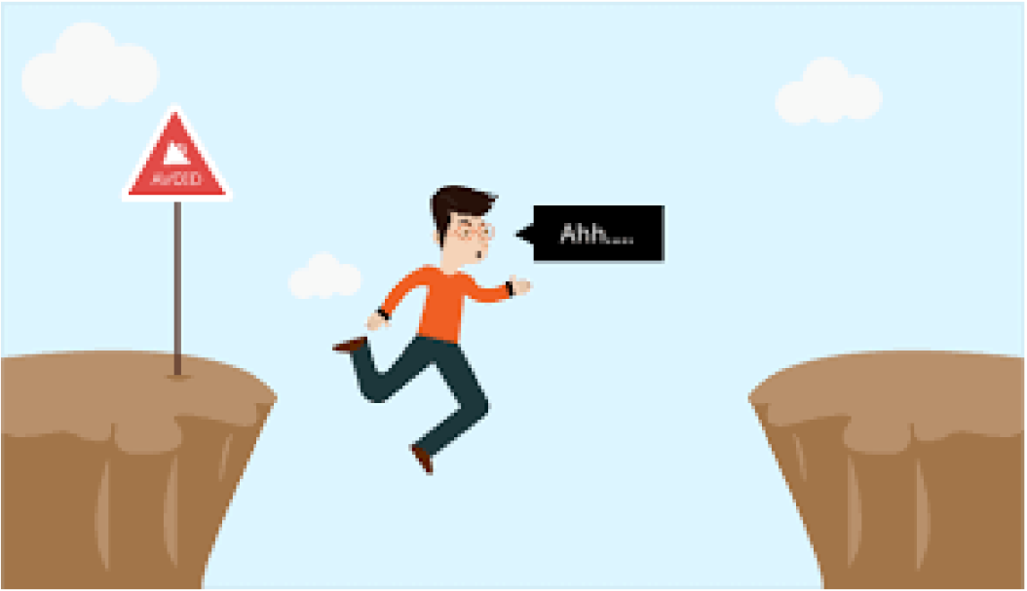
Common Off-Service Resident Pitfalls- and how to avoid them

Slide 32
Common Order Errors
Use the frequent orders tab! This will avoid many lab and imaging errors.

Slide 33
Common Lab orders
Sexually Transmitted Infections
Order GC/ Chlamydia/Trichomonas as a BUNDLE
Use Order set
Do not send genital cultures for BV- treat based on symptoms
Urinalyses
2 available orders as “UTI symptoms” or “No UTI symptoms”
“no UTI symptoms” we NEVER GET A CULTURE

Slide 34
ED Referrals
To refer a patient to the correct outpatient clinic when discharging:
Dispo Tab
Follow-up section
Type “ED REF”
Pick correct service/ clinic
DO NOT pick YHP (yale health plan) options if patient is not a YHP patient
Phone number should never be 633-4242 (main hospital number)

Slide 35
Safe Discharge
Make sure the patient knows:
What their diagnosis is/ is not
What the patient needs to do
Pick up medications (confirm best pharmacy and make sure open when needed)
Follow up with Dr. X
Wound care, suture removal, etc.
Why the above is important
Follow-up Requests for anyone you feel needs to be “checked on” or will need help navigating healthcare
They will also be calling them with abnormal test results automatically, so no need to flag for this
Follow-up office is available 6am-4pm daily and can be reached with questions in real time at 203-688-1051
Ortho: follow-up attending should be the one on call at time the patient arrived in ED unless told otherwise be consulting resident.
Notes:
Added note on pharmacy best practices

Slide 36
The ED Patient with Chest Pain

Slide 37
Chest Pain: Background
5% of all ED visits = 5 million visits per year in the US
One of the highest-risk chief complaints
For patient morbidity/ mortality
For MD litigation
Wide differential- most is high mortality. IN THE ED, WE MUST THINK OF WHAT WILL KILL THE PATIENT
Acute Coronary Syndrome
Pulmonary Embolism
Aortic Dissection
Pneumonia
Pneumothorax
Pericarditis
Esophageal Rupture

Slide 38
ACS: STEMI=CATH LAB ACTIVATION
National guidelines for STEMI cath lab activations:
Door-to-EKG: 10 minutes
Door-to-balloon: 90 minutes
All EKGs seen and interpreted by an attending immediately
“Cath Lab activation” is done by ED attending
Cath lab personnel are assembled (if not in-house overnight)
Cath lab attending gives a call to the ED attending to get quick story
NO role for… prior to activation:
Cardiac enzyme results
Cardiology Fellow consult
Chest x-ray results
Patient needs to be rolling to the cath lab within 25 minutes from arrival at ED triage, having gotten:
ASA 325mg
Plavix/ Ticagrelor (Brilanta) 180mg PO
Heparin 5000U
+/- Oxygen
+/- morphine
+/- nitroglycerin
+/- Beta-blocker
ACTIVATION IS BASED PURELY ON EKG and PATIENT’S PRESENTATION

Slide 39
ACS: STEMI=CATH LAB ACTIVATION
What does the attending look for to activate cath lab?
Activation Criteria
ST elevations of >1mm in 2 consecutive (anatomical) leads
Other signs that may be present (but not part of criteria for activation)
Dysrhythmia
Reciprocal changes
Dynamic changes
New LBBB

Slide 40
ACS: “Good Story”
What if the EKG is not clear-cut, but the patient is giving a “classic MI story”
No immediate cath lab activation: role of cardiology consult
Resident calls fellow
Attending calls attending
Instruct the nurse to do q10min. EKGs
Dynamic EKG changes→ activate cath lab
Possibilities for ACS: all should get heparin
Good story – EKG changes – troponins = unstable angina/ ACS
Good story – EKG changes + troponins = NSTEMI/ACS
Good story + EKG changes (+/- troponins) = STEMI/ACS
Especially if came in first few hours (<6 hours)
Bad story/ no CP – EKG + troponins= NOT ACS
Look for other causes of troponins
ESRD
Tachycardia/ Sepsis
Myocarditis

Slide 41
Chest Pain Patient Disposition
Low/Moderate Risk CP
High Risk CP
ED chest pain pathway helpful for guidance (i.e. what to do next based on high-sensitivity troponin results)
Need a ROMI
EKG and enzymes q3-6hrs x 3 times +/- stress
In-hospital ROMI vs. CPC
Decision made by ED attending in consultation with cardiologist and PMD
ACS
Heparin gtt
Unstable vital signs
Cardiology team
Goodyer / General Cardiology
telemetry
CCU/CSDU
Notes:
Added note that ED chest pain pathway helpful for guidance

Slide 42
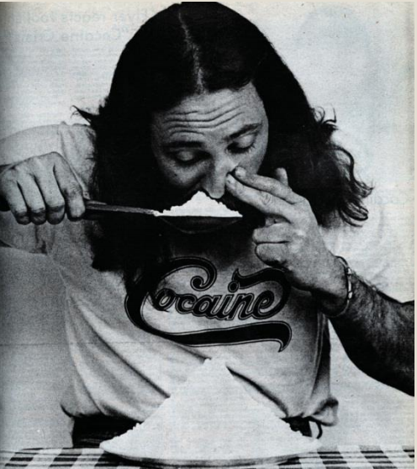
Cocaine Use Chest Pain
Rule in approx. 6% of time
Avoid Beta-Blockade
Treat chest pain and/or tachycardia with benzodiazepines

Slide 43
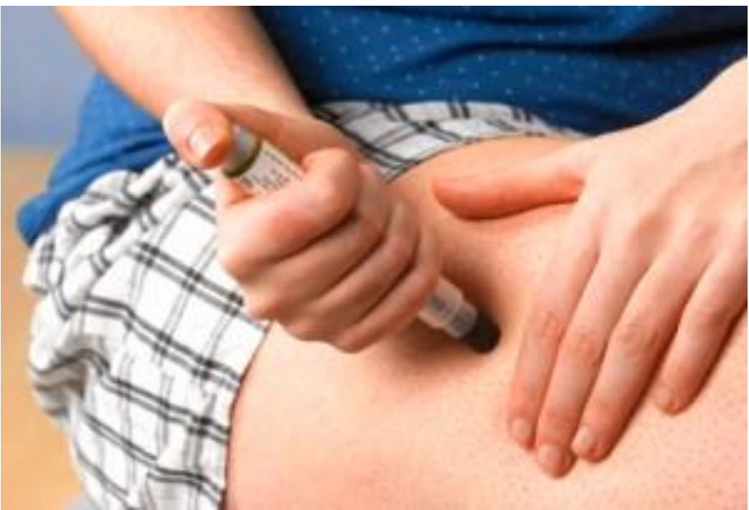
The ED Patient with Anaphylaxis

Slide 44
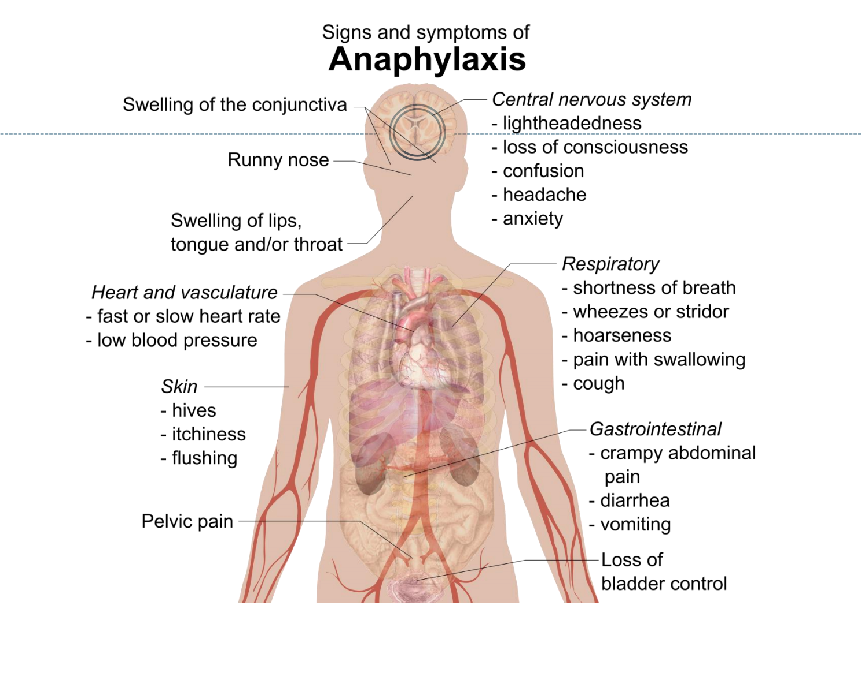

Slide 45
Anaphylaxis/Angioedema
Immediate Medications
Epinephrine:
Mild- moderate: 0.3mL of 1:1000 dilution IM in thigh
May repeat q5min. Up to max 3 doses
EPIPEN
Severe: 1-5mL of 1:10,000 IV drip over 10min…continuous
Solu-Medrol 125mg IV
Benadryl 50mg IV
Pepcid 20mg IV
Fluids
Albuterol PRN

Slide 46
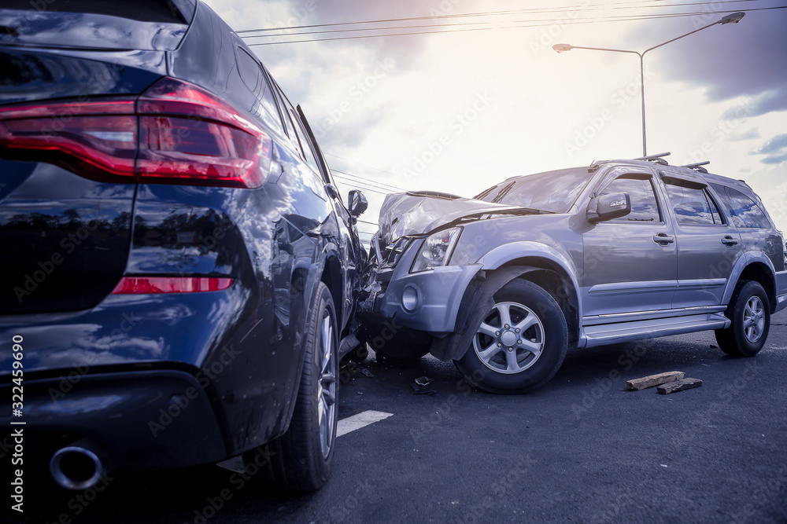
The ED Trauma Patient
Notes:
Photo changed to more neutral photo (photo of car accident)

Slide 47
The Trauma Patient
There are triage criteria for activating “trauma alerts” for patients: “full trauma” vs. “modified trauma”
You are responsible for those who didn’t meet criteria THIS DOES NOT MEAN THAT THEY ARE NOT SERIOUSLY INJURED
Most have c-spine collars
Never remove a c-collar without attending approval/clearance
Don’t allow a patient to remove a c-collar

Slide 48
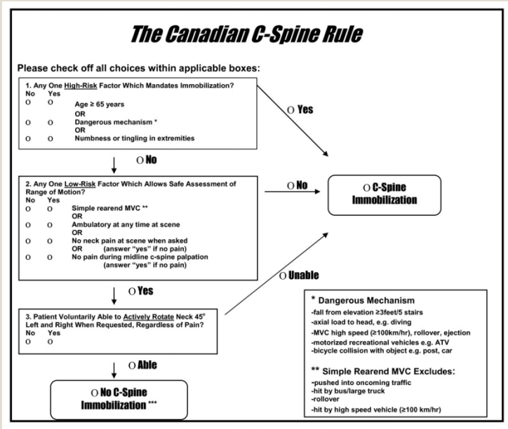
Clearing a C-Collar
Done by senior resident/ attending ONLY
Clinical Rules for clearing C-collars
Canadian
Nexus – cannot clear if:
Midline tenderness
Focal neurological deficits
Altered level of consciousness
Intoxication
Distracting Injury
Notes:
Clarified that NEXUS says cannot clear if following characteristics present

Slide 49
Trauma ABCDE’s
Airway
Breathing
Circulation
Disability (GCS)
Exposures
Document all injuries and formulate a plan for intervention/imaging if necessary

Slide 50
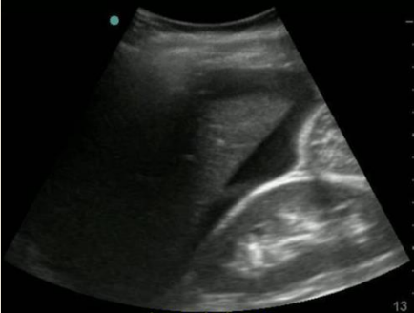
FAST Exam
Focused Assessment by Sonography for Trauma
Ultrasound exam looking for free fluid
Abdomen: RUQ/ LUQ
Pelvis
Pericardial Effusion
E-FAST: extended FAST
Examines for pneumothorax
More sensitive than supine x-ray
Validated in unstable patients
Can not be used to exclude intra-abdominal trauma

Slide 51
“Pan-Scan”
“Pan-scan”= CT scan
Head (no contrast)
C-spine (no contrast)
Chest/ Abdomen/ Pelvis with IV contrast
T-/L- Spine reconstructions

Slide 52
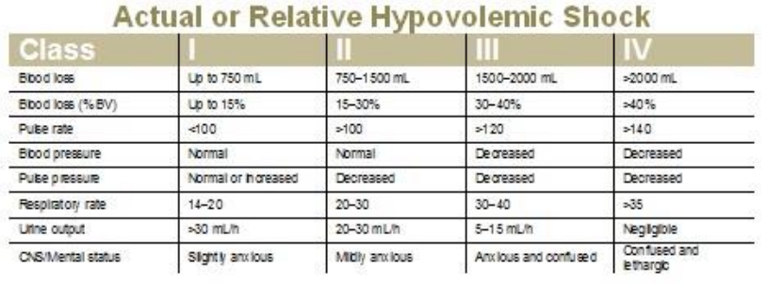
More Trauma Pearls
Laceration/ Abrasion
Tetanus
Contaminated wound: ?Antibiotics
Beware
Intracranial hemorrhage
Old people: subdural/ intraparenchymal bleeds
Splenic lacerations
Immediately alert the attending for any vital sign abnormalities or changes in mental status
Vital Signs
Narrow pulse pressures
Mild tachycardia
Cause of trauma: mechanical vs. medical

Slide 53
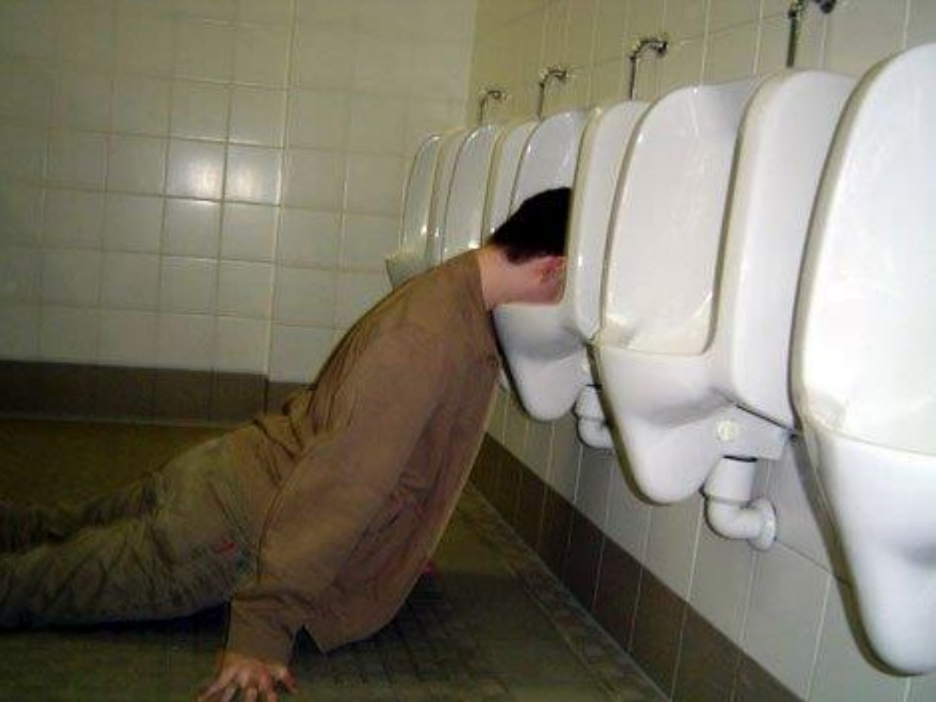
The Intoxicated ED Patient

Slide 54
Intoxication
Need to be screened for other causes of their altered mental status
Hypoglycemia
Head trauma
Other toxic ingestions
At minimum:
Vital signs
Point of Care Blood Sugar
Consider whether any further testing would change management or disposition
Most cases will not need serum overdose/ urine tox
Document suicidal or homicidal ideation
Re-evaluate after clinical sobriety
Detox Counselors- Project Assert

Slide 55
Intoxicated Patients
Clinical sobriety: no slurred speech, normal gait
Alcohol levels decrease by ~ .025/ hour
Look over all documents in patient’s chart
Police “paper”
Requires “physician clearance”
Nursing/ triage/ call-in sheets
If medical evaluation is negative, and patient is intoxicated, must hold until clinically sober

Slide 56
Overdose: Physical Exam
Vital Signs
Pupils
Pulmonary Edema
Skin
Bowel Sounds
Mental Status

Slide 57
Overdose
Document suicidal/homicidal ideation (SI/HI) on all overdose/ intoxicated patients
SI/HI must be re-assessed when clinically sober
Consider overdose in any patient with SI
Poison Control 1-800-222-1222 must be called for all ingestions/ overdoses (other than street drugs/ etoh)
On-call toxicologist is available 24hr
Get EKG
Consider overdose labs: Serum tox, LFTs, Utox

Slide 58
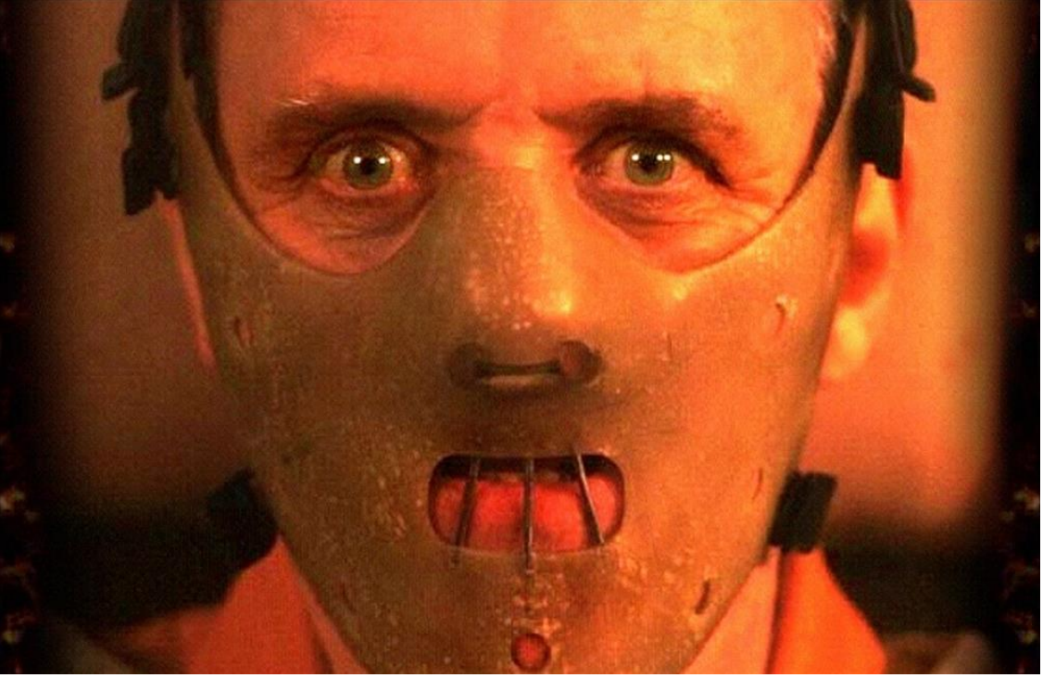
The ED Patient with Psychiatric Compliant or Ingestion

Slide 59
Medical Clearance
Patients going to CIU require medical clearance if
Over 50yo
Has any medical PMHx
What needs to happen:
Full physical exam
Consider overdose
Some may need: EKG/ CXR/ Basic Labs
Medical clearance means:
All medical problems resolved
No IVs in
Medically stable
Overdose patients are not medically clear if the overdose is still being addressed
Check past charts
Psychiatric patients may not be forthcoming with their PMHx
Once cleared:
Epic order “psych clearance”
Alert patient’s nurse for CIU transfer to take place

Slide 60
THANK YOU FOR YOUR ATTENTION
Questions/Concerns?
Please contact the EM Chiefs
Or
Dylan Devlin, MD
Director of Off-Service Residents
dylan.devlin@yale.edu

